Slide 1
Debenham and Storm Babet
Name
Job title
Date

Slide 2
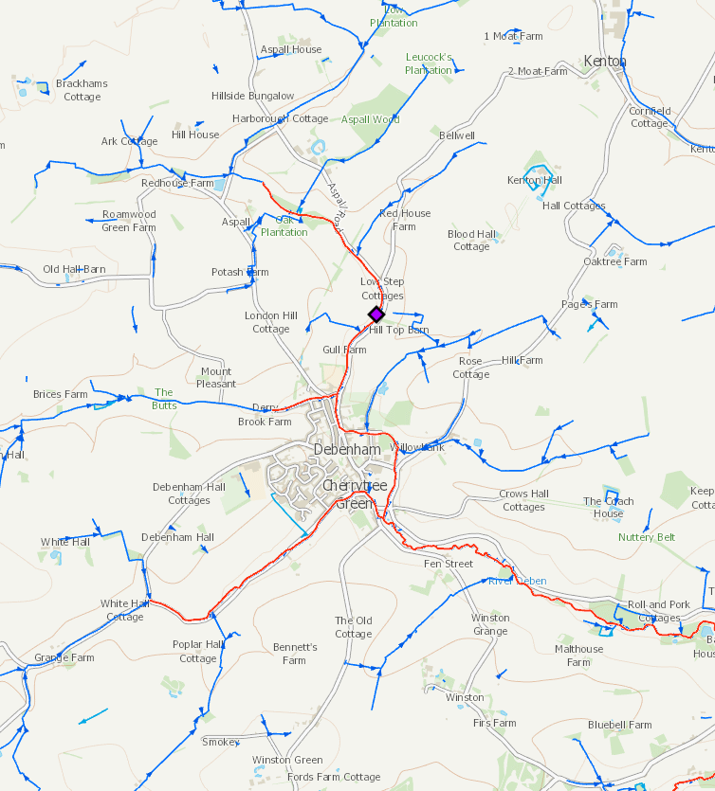
Main Rivers and Ordinary Watercourses
Main Rivers – The Gulls, Derry Brook, Cherry Tree Watercourse and River Deben
Shows upstream flow gauge on The Gulls Watercourse

Slide 3
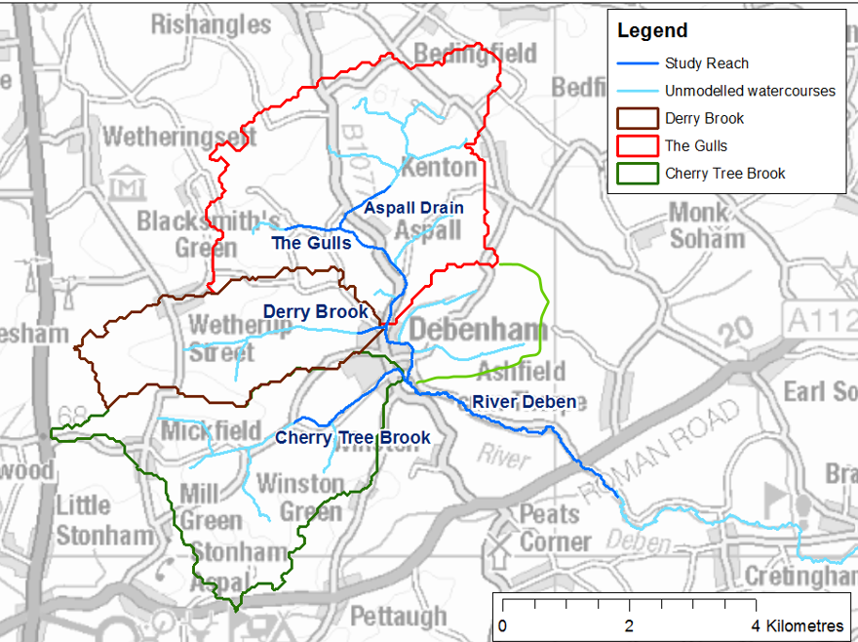
Catchment areas
The Gulls/Aspall Drain: 13km²
Cherry Tree watercourse: 10km²
Derry Brook: 6.5km²
Un-named catchment 3km²

Slide 4
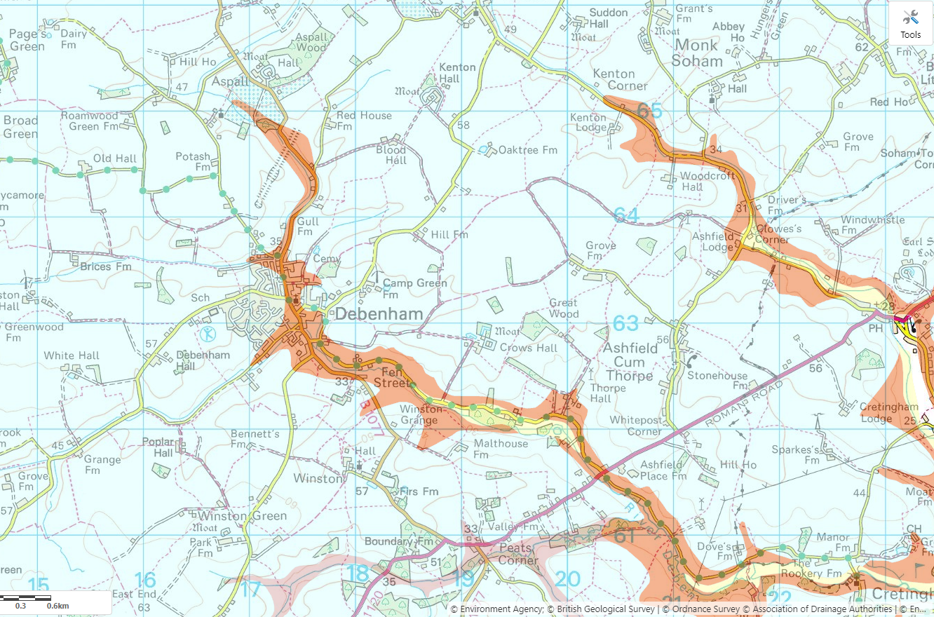
Geology
Blue = Clay in upstream catchment
Orange = Sand and gravels along river channel
Yellow = Alluvium (Clay, silt, sand and gravel) downstream

Slide 5
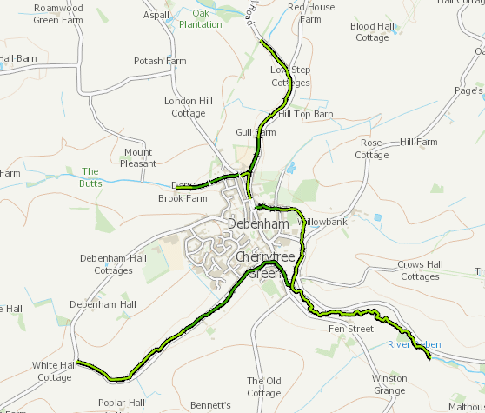
Green – Natural River Banks

Slide 6
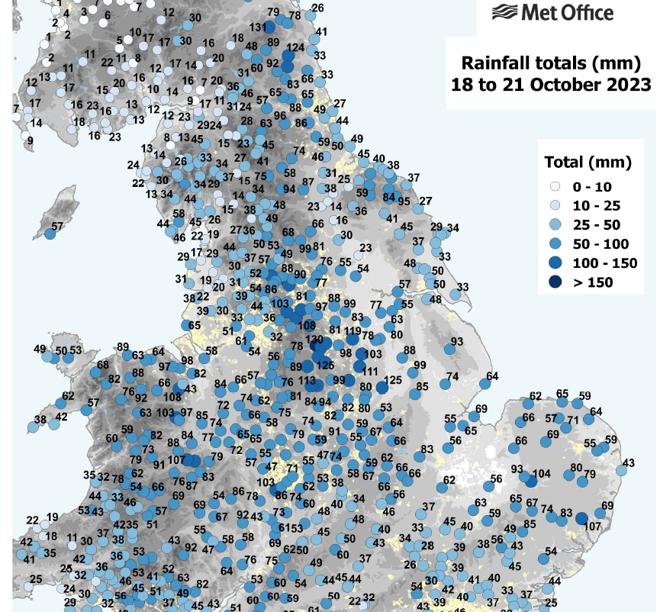
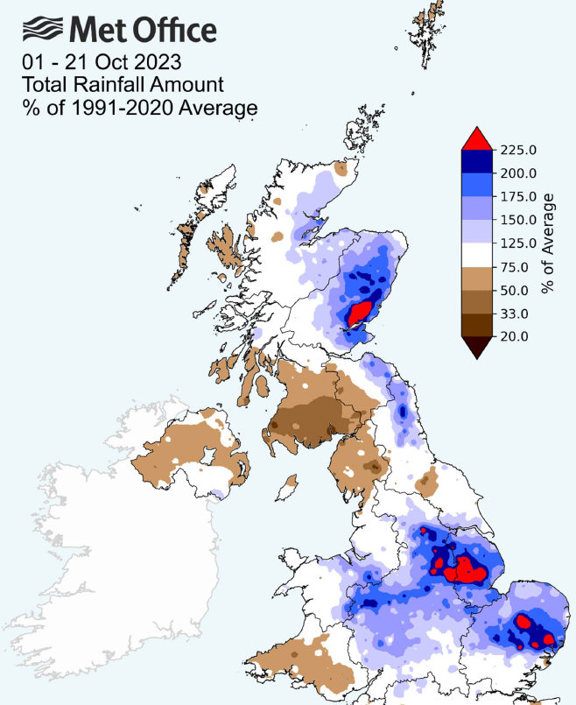
Met Office Report into Storm Babet
“19 October 2023 was, by a wide margin, the wettest day on record in a series from 1891”.
“18-20 October was the third-wettest independent 3-day period for England and Wales in a series from 1891”.

Slide 7
Rainfall intensity Earl Soham Rainfall Gauge

Slide 8
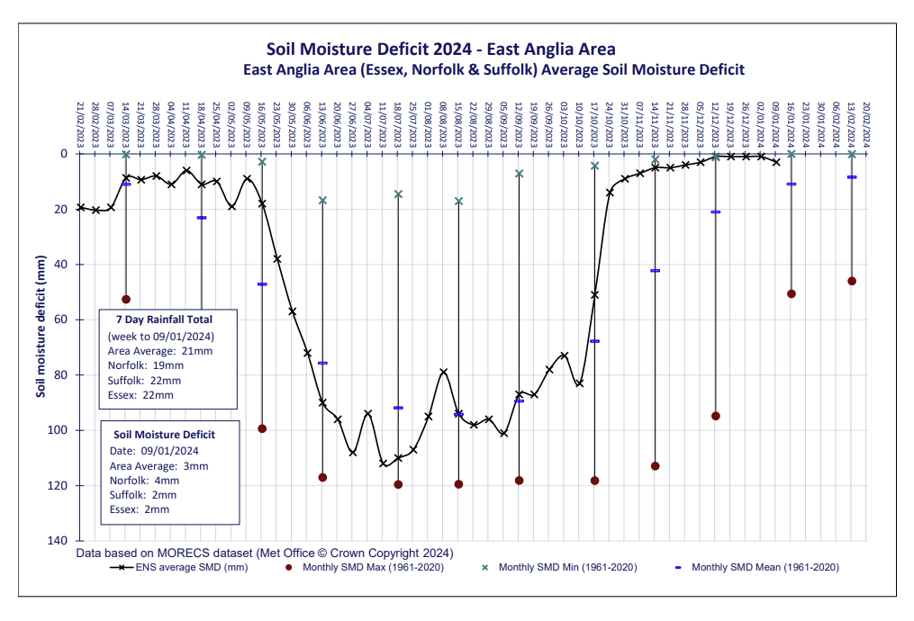
Soil Moisture Deficit

Slide 9
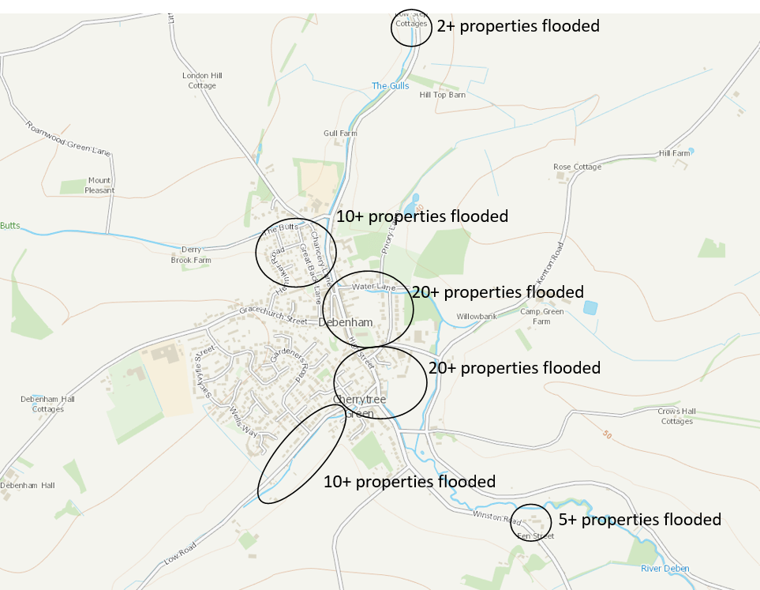
Properties flooded in Storm Babet

Slide 10
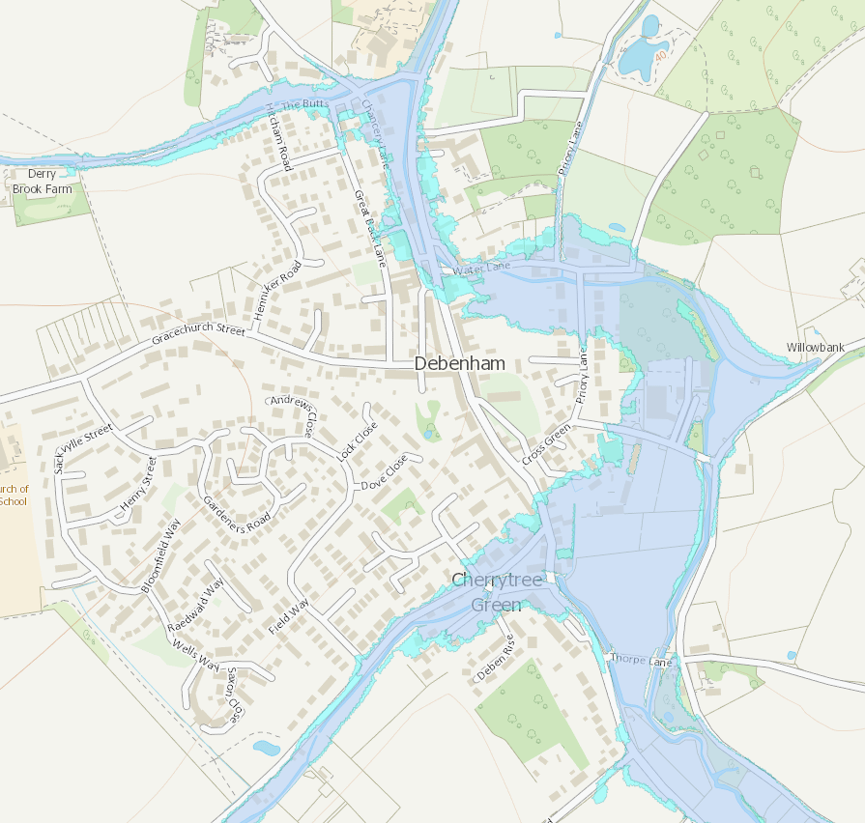
Flood Zones - river flooding
Flood Zone 3
High Probability = 1% Annual Exceedance Probability (1 in 100 chance each year)
Flood Zone 2
Medium Probability = 0.1% Annual Exceedance Probability (1 in 1000 change each year)

Slide 11
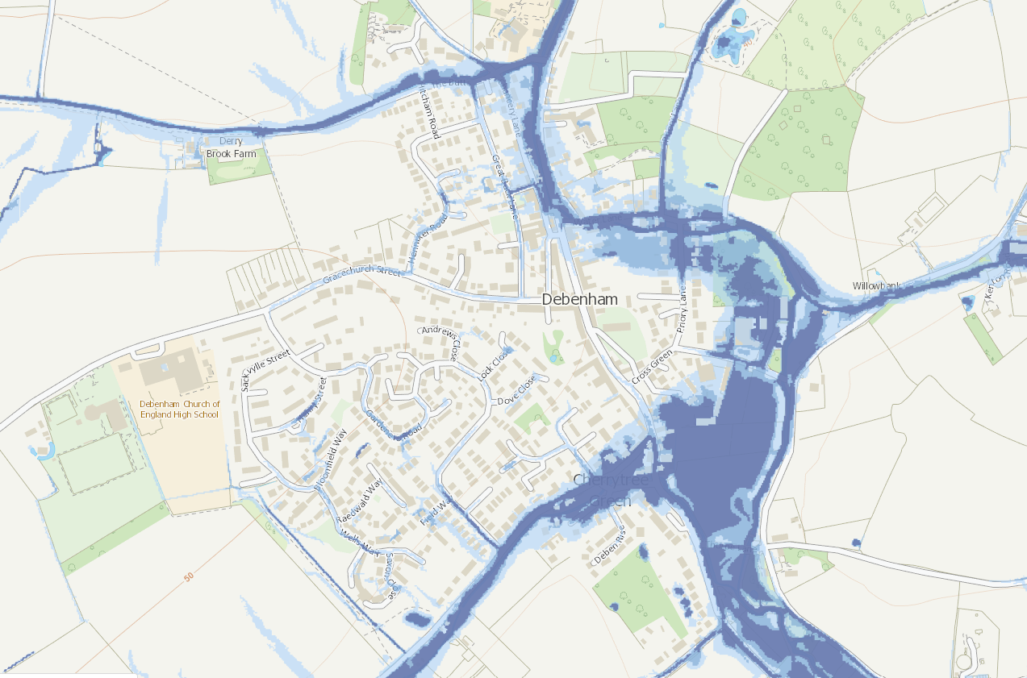
Flood Map for Surface Water
3.3% (1 in 30 chance each year) Annual Exceedance Probability
1% (1 in 100 chance each year) Annual Exceedance Probability
0.1% (1 in 1000 chance each year) Annual Exceedance Probability

Slide 12
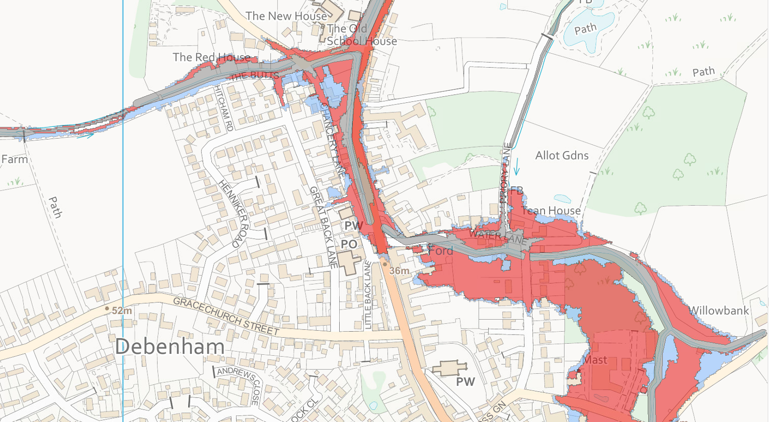
Modelled Flood Extents
50% (1 in 2 chance each year) Annual Exceedance Probability
5% (1 in 20 chance each year) Annual Exceedance Probability
1% (1 in 100 chance each year) Annual Exceedance Probability

Slide 13
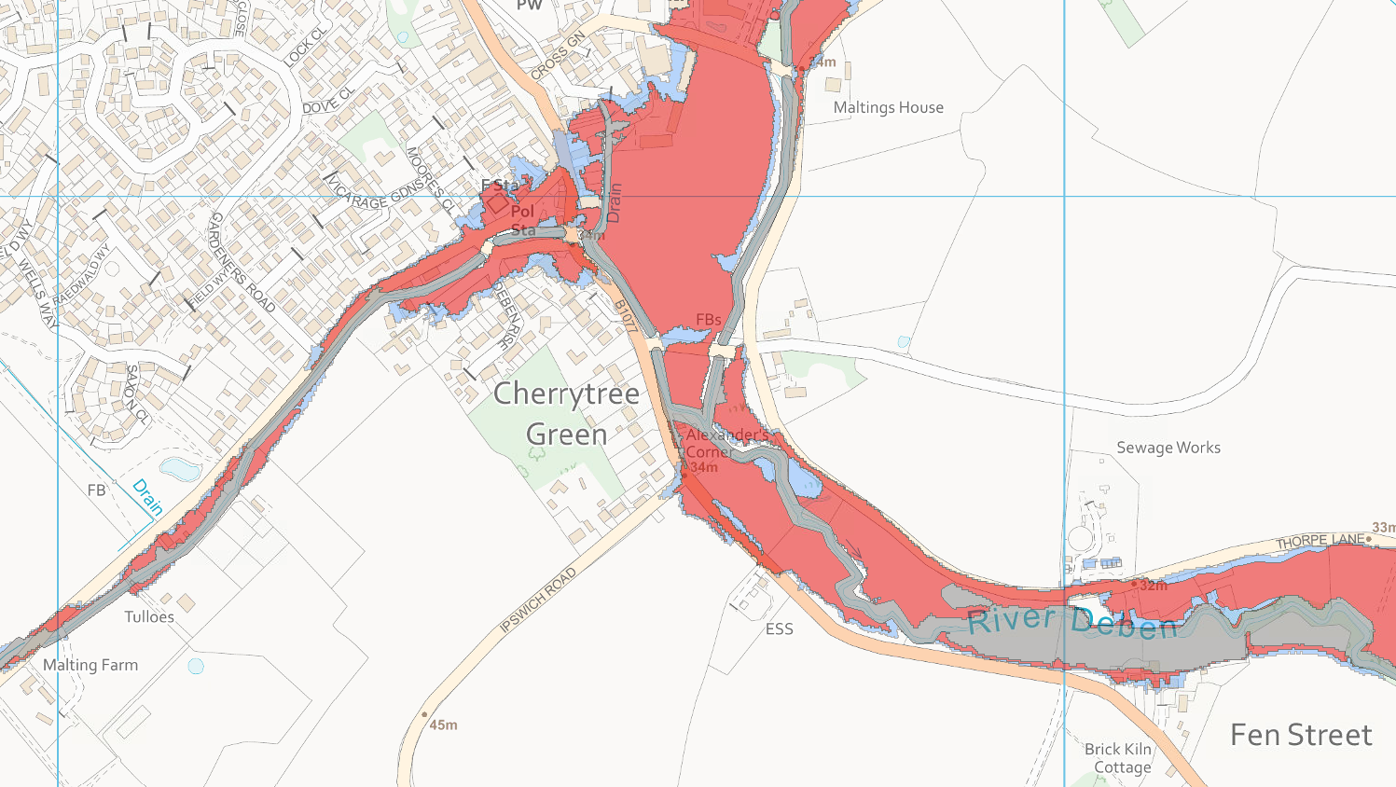
Modelled Flood Extents
50% (1 in 2 chance each year) Annual Exceedance Probability
5% (1 in 20 chance each year) Annual Exceedance Probability
1% (1 in 100 chance each year) Annual Exceedance Probability

Slide 14
BLANK

Slide 15
Additional information to support questions

Slide 16
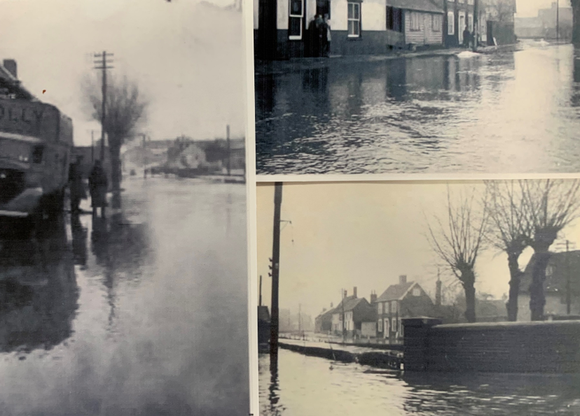
Flood History
Long history of significant flood events
1912, 1927, 1936, 1944, 1947, 1956, 1968, 1986, 1993, 1994, 1995

Slide 17
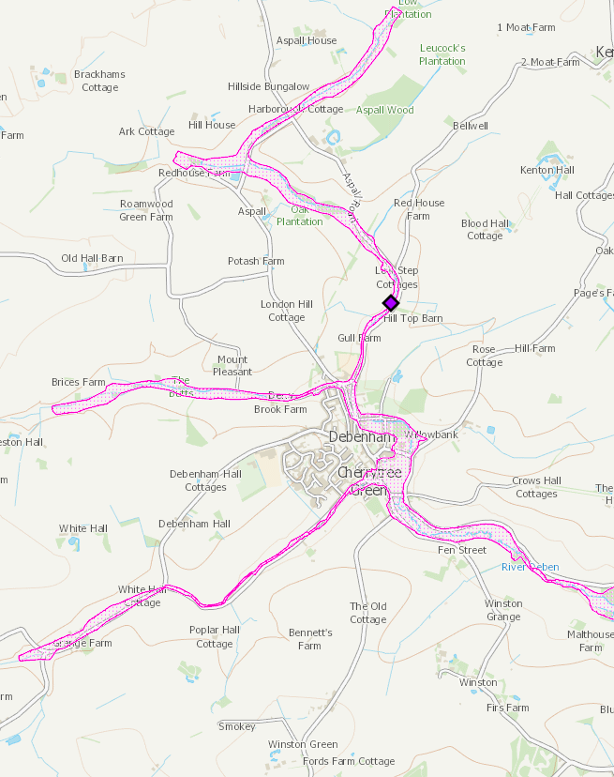
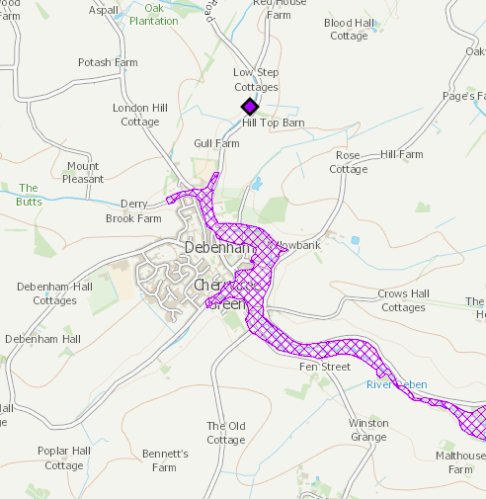
Flood Warning Area
Flood Alert Area

Slide 18
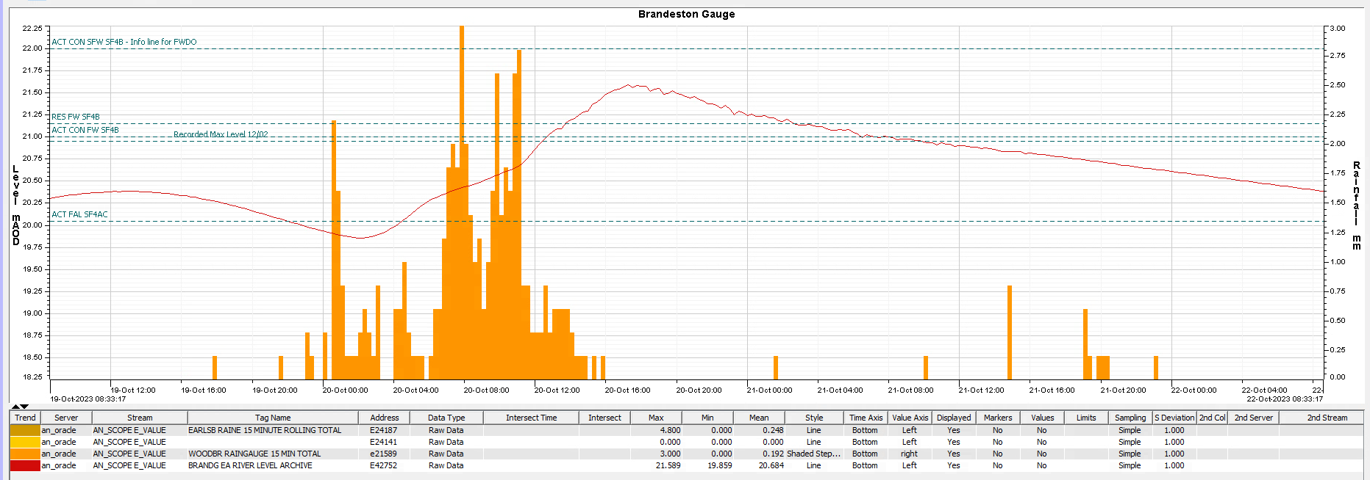
Brandeston Gauge downstream on the River Deben
Maximum level reached was 0.6m above the previous maximum recorded level in 2009

Slide 19
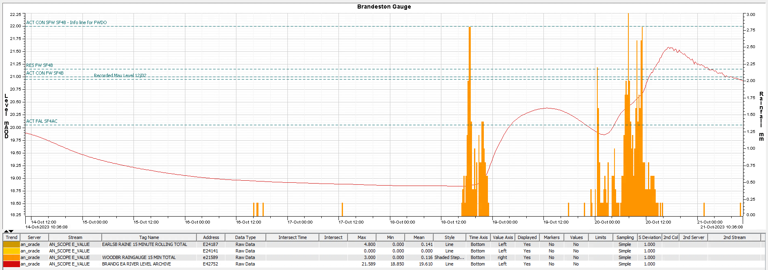
Brandeston Gauge – previous rainfall and river reaction
The river was still high after previous rainfall on the 18 October, and was almost above Flood Alert level already, when the rainfall on the 20 October arrived and caused it to react quickly.

Slide 20
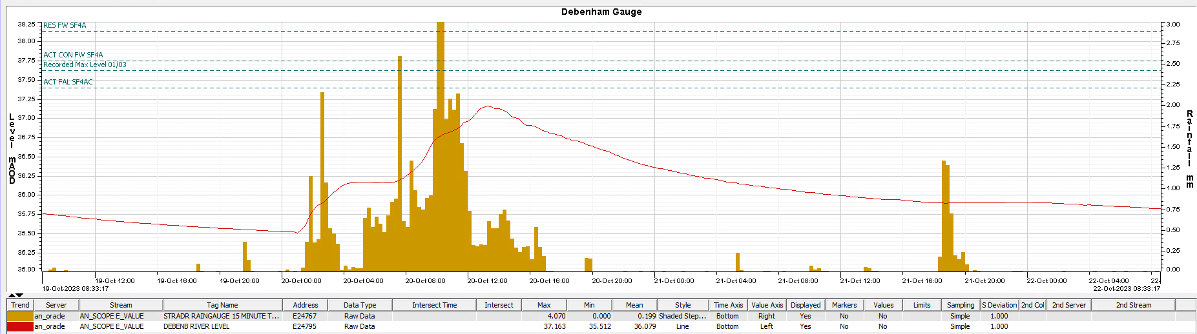
Debenham Gauge on The Gulls Watercourse upstream of Debenham
The gauge did not respond as expected, this could be because of an error, because the gauge was bypassed with flows along the road, or because the water didn’t reach the river and flowed down the road instead. We would welcome any information you may have about the flood event in this location.

Slide 21
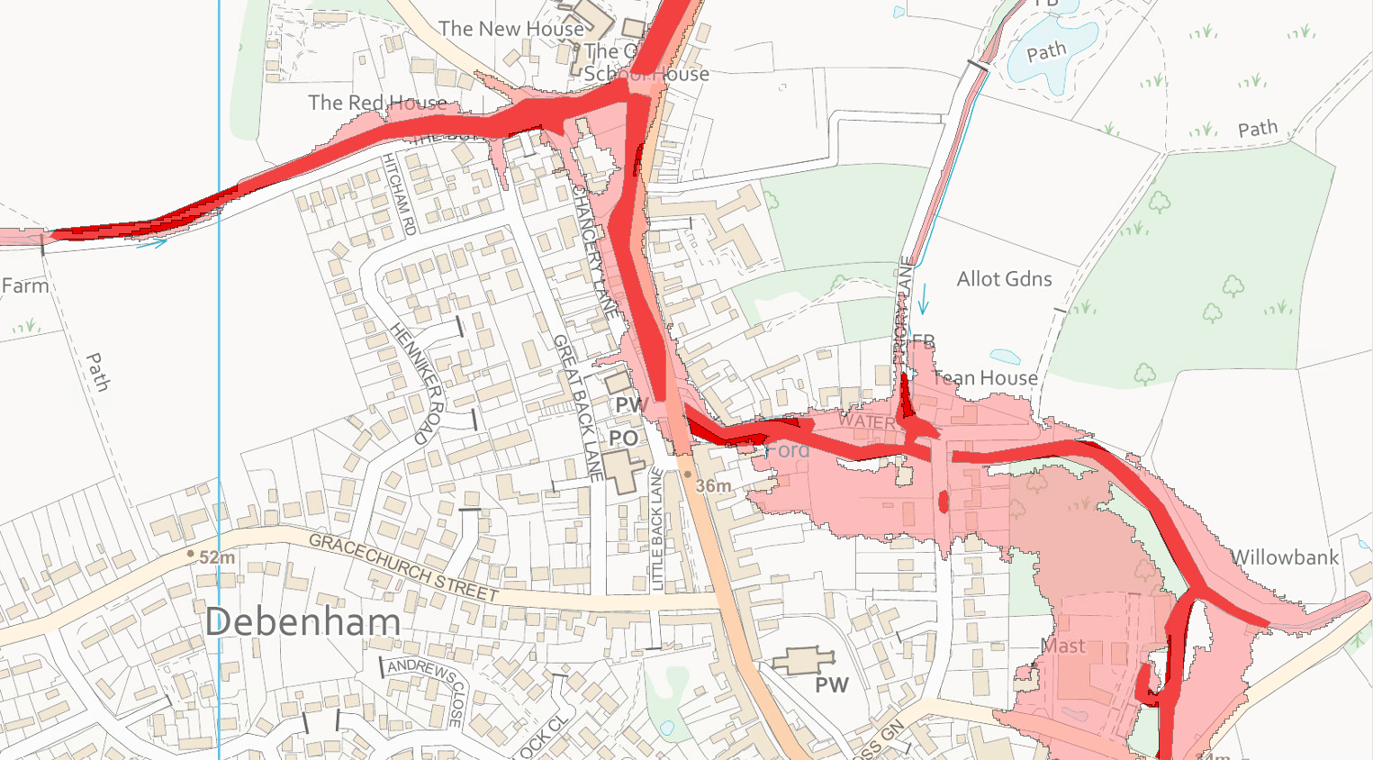
Comparison of 2010 and 2017 modelling
5% (1 in 20 Year) Annual Exceedance Probability – Old 2010 Model
5% (1 in 20 Year) Annual Exceedance Probability – New 2017 Model
1% flood levels increased by 0.71m around Chancery Lane, and by 0.88m around Water Lane, in the 2017 modelling.

Slide 22
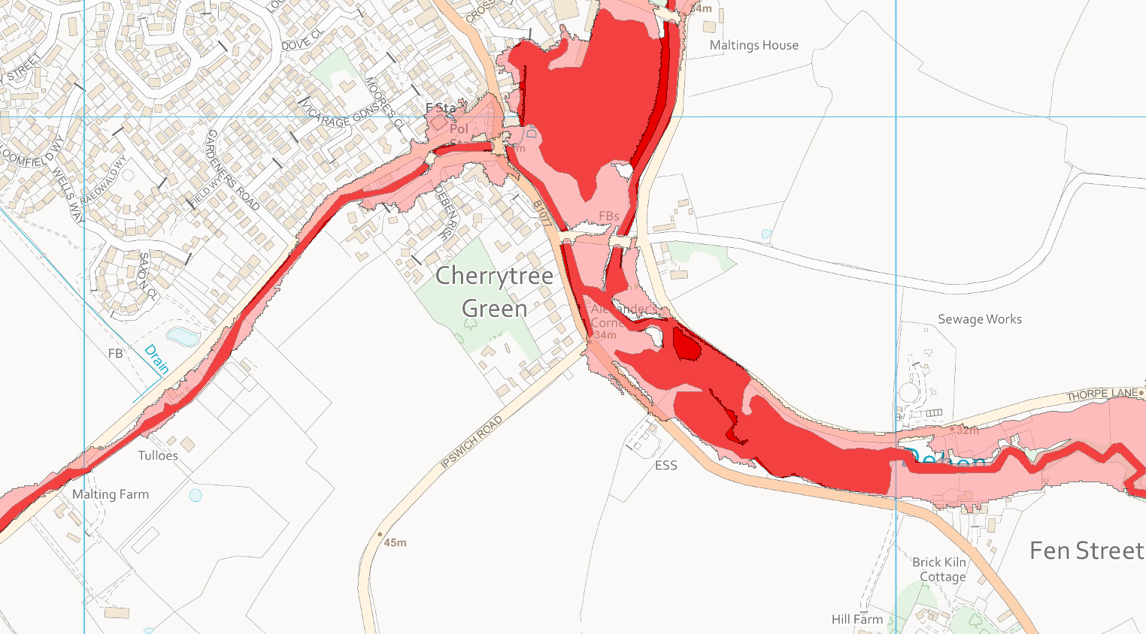
Comparison of 2010 and 2017 modelling
5% (1 in 20 Year) Annual Exceedance Probability – Old 2010 Model
5% (1 in 20 Year) Annual Exceedance Probability – New 2017 Model
5% flood levels increased by about 0.75m along Low Road and by 0.81m at Fen Street, in the 2017 modelling.

Slide 23
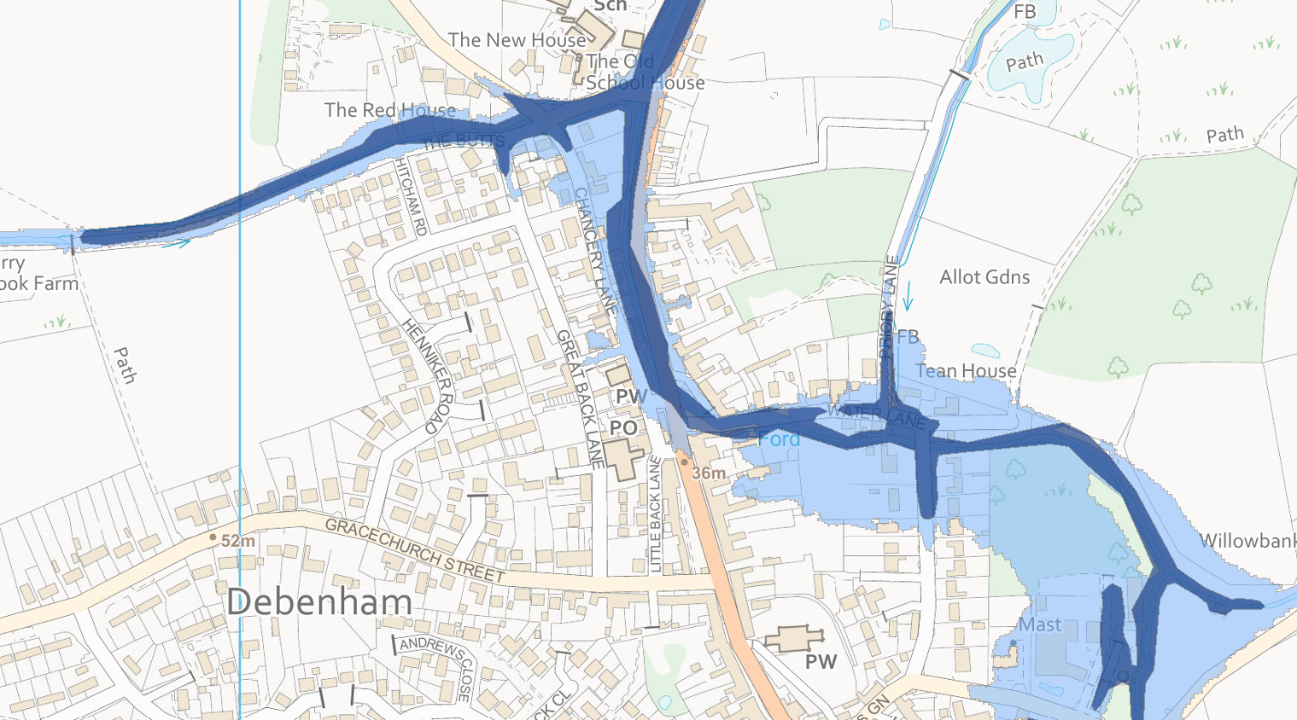
Comparison of 2010 and 2017 modelling
1% (1 in 100 Year) Annual Exceedance Probability – Old 2010 Model
1% (1 in 100 Year) Annual Exceedance Probability – New 2017 Model
1% flood levels increased by 0.68m around Chancery Lane, and by 0.73m around Water Lane, in the 2017 modelling.

Slide 24
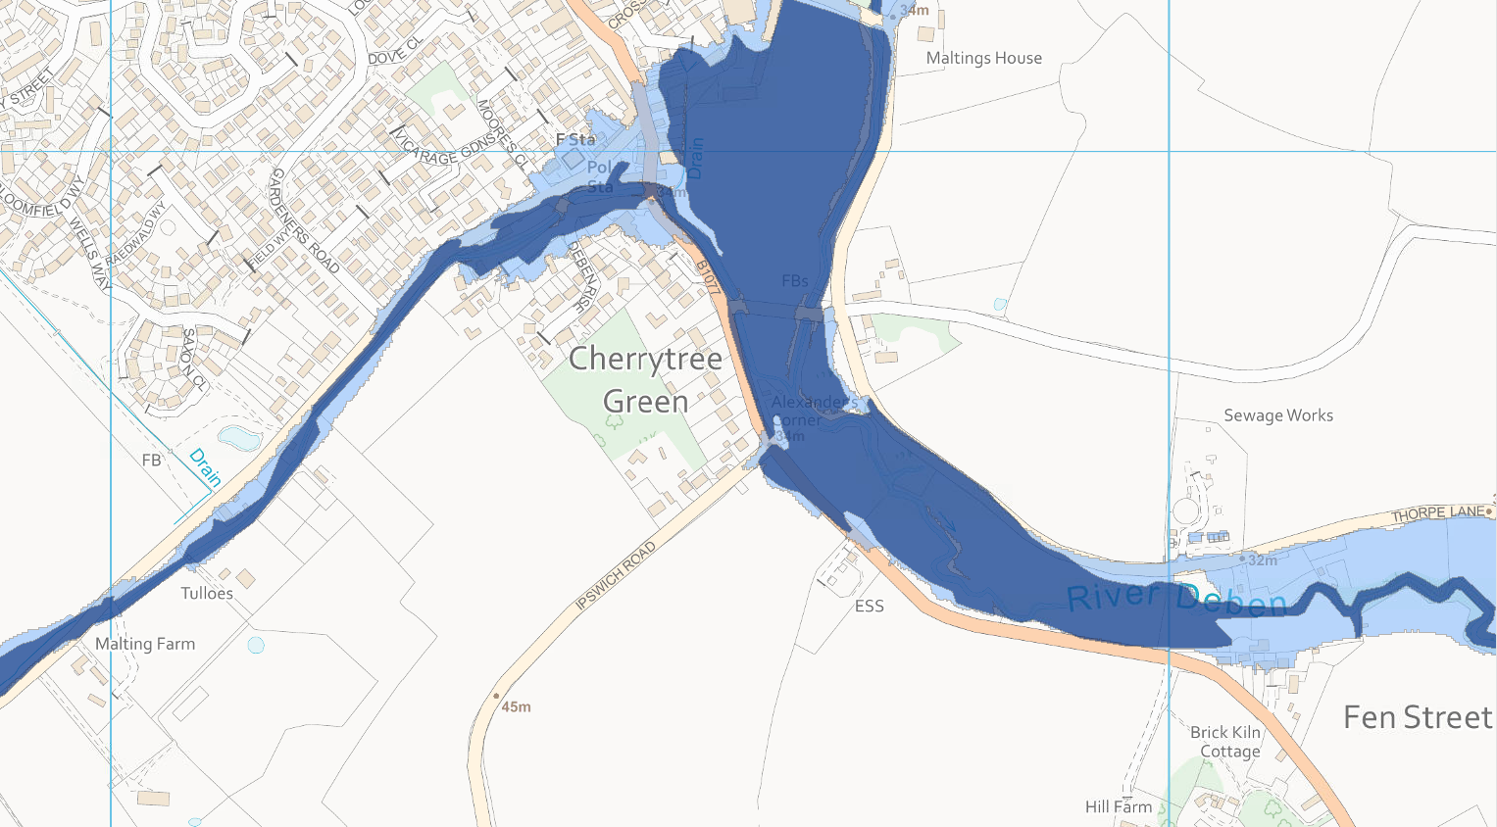
Comparison of 2010 and 2017 modelling
1% (1 in 100 Year) Annual Exceedance Probability – Old 2010 Model
1% (1 in 100 Year) Annual Exceedance Probability – New 2017 Model
1% flood levels increased by 0.64m to 0.74m along Low Road and at Fen Street, in the 2017 modelling.

